Slide 1
Lecture 5
System of Linear Equations

Slide 2
Objective:
Solve the system of linear equations to find the solution of the system and determine the conditions of no solution, more than one solution and unique solution.
Methodology:
There are three commonly used methods to solve system of linear equations:
Using elementary row operations (Gaussian elimination and Gauss-Jordan elimination),
Using inverse matrix,
Cramer’s rule.

Slide 3
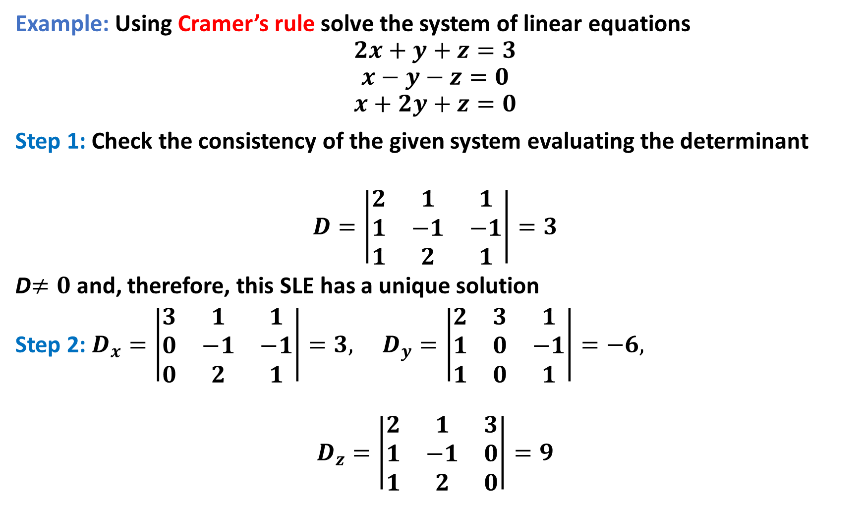
Example: Using Cramer’s rule solve the system of linear equations
$$2x+y+z=3$$
$$x−y−z=0$$
$$x+2y+z=0$$
Step 1: Check the consistency of the given system evaluating the determinant
$$D=\left|\begin{matrix}2 & 1 & 1 \\ 1 & −1 & −1 \\ 1 & 2 & 1\end{matrix}\right|=3$$
D$≠0$ and, therefore, this SLE has a unique solution
Step 2: $D_{x}=\left|\begin{matrix}3 & 1 & 1 \\ 0 & −1 & −1 \\ 0 & 2 & 1\end{matrix}\right|=3, D_{y}=\left|\begin{matrix}2 & 3 & 1 \\ 1 & 0 & −1 \\ 1 & 0 & 1\end{matrix}\right|=−6,$
$$D_{z}=\left|\begin{matrix}2 & 1 & 3 \\ 1 & −1 & 0 \\ 1 & 2 & 0\end{matrix}\right|=9$$

Slide 4

Step 3: Now, according to Cramer's rule:
$$x=\frac{D_{x}}{D}=\frac{3}{3}=1,$$
$$y=\frac{D_{y}}{D}=\frac{−6}{3}=−2$$
$$and z=\frac{D_{z}}{D}=\frac{9}{3}=3$$

Slide 5

Some related exercise:
$\begin{matrix} x+2y+4z =−13 \\ 3x− y+z=5 \\ x+3y =3\end{matrix}$
$\begin{matrix}3x+y+2z=14 \\ 2y+5z=22 \\ 2x+5y−z=−22\end{matrix}$
$\begin{matrix}−3x+2y−3z=−8 \\ 2x −y +z =4 \\ x +2y −4z=−2\end{matrix}$

Slide 6
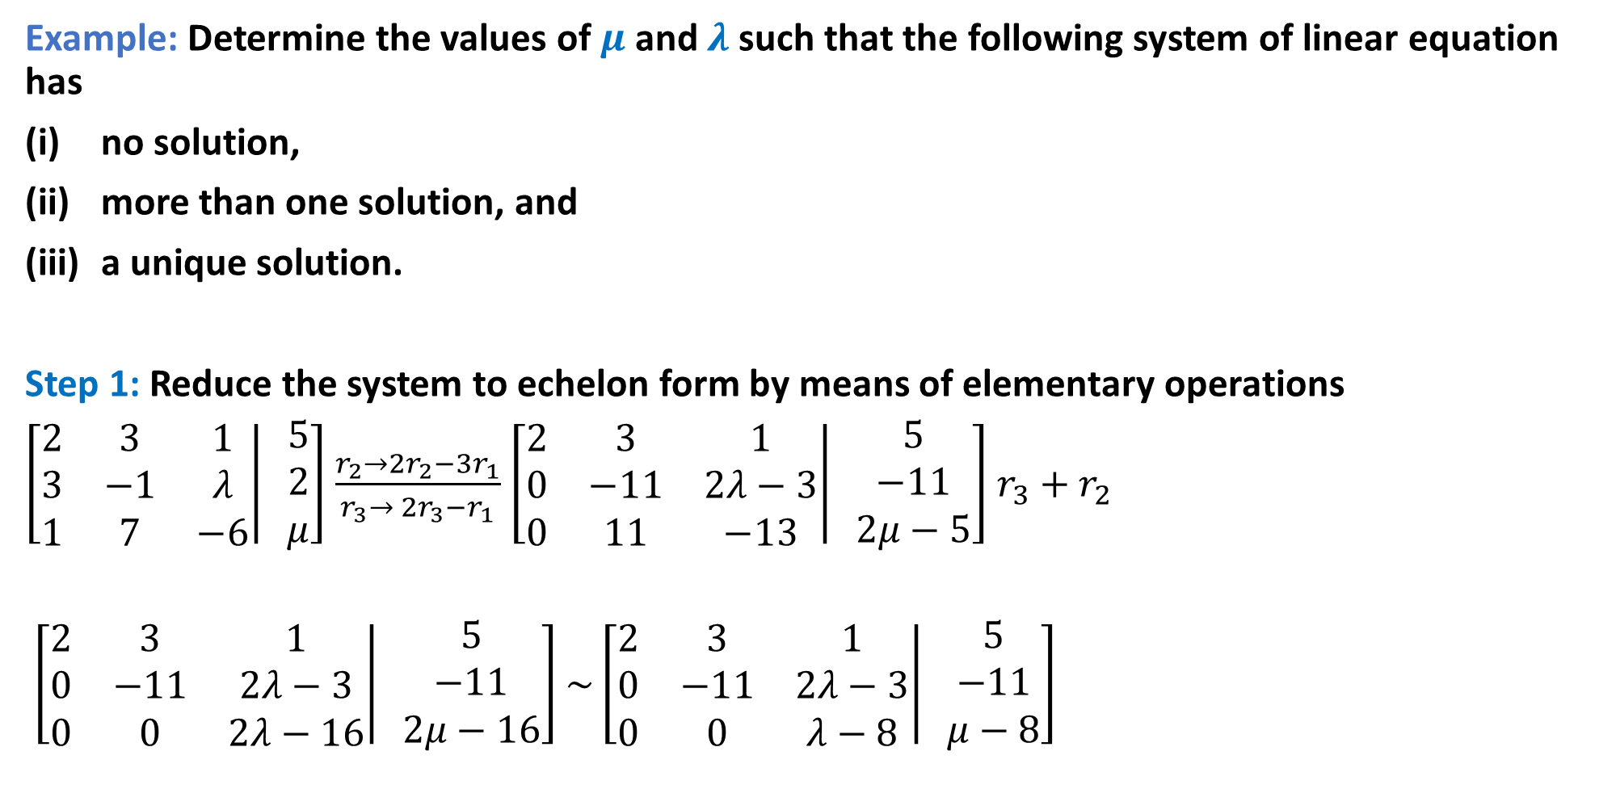

Example: Determine the values of $μ$and $λ$ such that the following system of linear equation has
no solution,
more than one solution, and
a unique solution.
Step 1: Reduce the system to echelon form by means of elementary operations
$\left[\left.\begin{matrix}2 & 3 & 1 \\ 3 & −1 & λ \\ 1 & 7 & −6\end{matrix}\right| \begin{matrix}5 \\ 2 \\ μ\end{matrix}\right]$ $\frac{r_{2}→{2r}_{2}−3r_{1}}{r_{3}→ {2r}_{3}−r_{1}}$ $\left[\left.\begin{matrix}2 & 3 & 1 \\ 0 & −11 & 2λ−3 \\ 0 & 11 & −13\end{matrix}\right| \begin{matrix}5 \\ −11 \\ 2μ−5\end{matrix}\right]$ $r_{3}+r_{2}$
$\left[\left.\begin{matrix}2 & 3 & 1 \\ 0 & −11 & 2λ−3 \\ 0 & 0 & 2λ−16\end{matrix}\right| \begin{matrix}5 \\ −11 \\ 2μ−16\end{matrix}\right]$ $\sim \left[\left.\begin{matrix}2 & 3 & 1 \\ 0 & −11 & 2λ−3 \\ 0 & 0 & λ−8\end{matrix}\right| \begin{matrix}5 \\ −11 \\ μ−8\end{matrix}\right]$
$$\left\{\begin{matrix}2x+3y+z=5 \\ 3x−y+λz=2 \\ x+7y−6z=μ\end{matrix}\right.$$

Slide 7
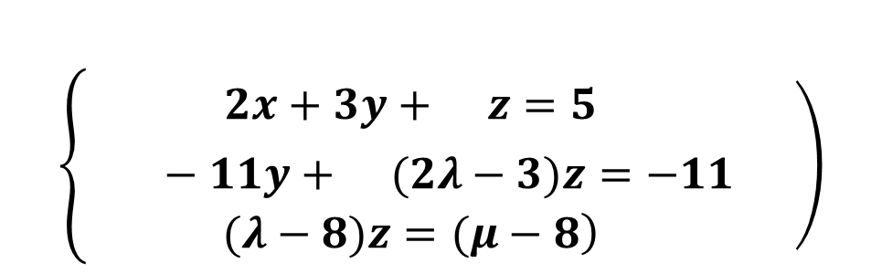
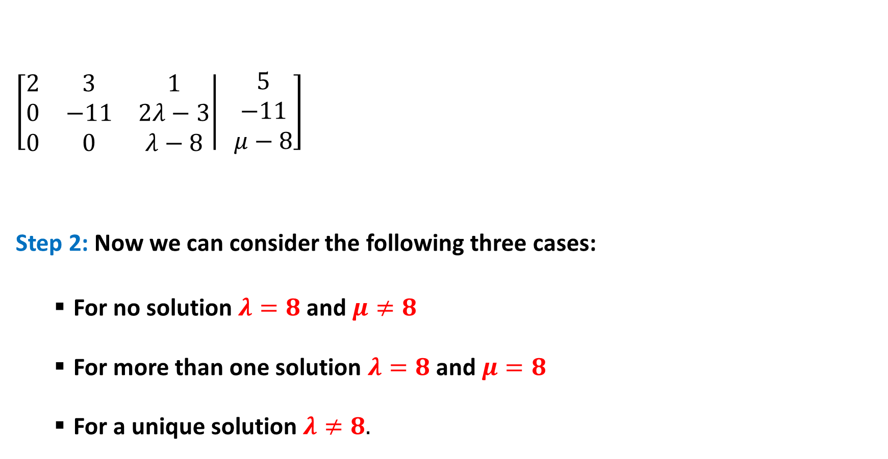
$\left[\left.\begin{matrix}2 & 3 & 1 \\ 0 & −11 & 2λ−3 \\ 0 & 0 & λ−8\end{matrix}\right| \begin{matrix}5 \\ −11 \\ μ−8\end{matrix}\right]$
Step 2: Now we can consider the following three cases:
For no solution$λ=8$ and$μ≠8$
For more than one solution $λ=8$ and$μ=8$
For a unique solution $λ≠8.$
$$\left\{\left.\begin{matrix}2x+3y+ z=5 \\ −11y+ (2λ−3)z=−11 \\ \left.(λ−8)z=(μ−8\right)\end{matrix} \right)\right.$$

Slide 8



Some related exercise:
1.
2. $\begin{matrix}x+y +z =2 \\ x+3y+λz=6 \\ x+2y+3z=μ\end{matrix}.$
3.
$$\left\{\begin{matrix}x −3z=−3 \\ 2x+λy−z =−2 \\ x+2y+λz=1\end{matrix}\right.$$
$$\left\{\begin{matrix}x+y+λz=1 \\ x+λy+z=λ \\ λx+y+z=λ^{2}\end{matrix}\right.$$

Slide 9

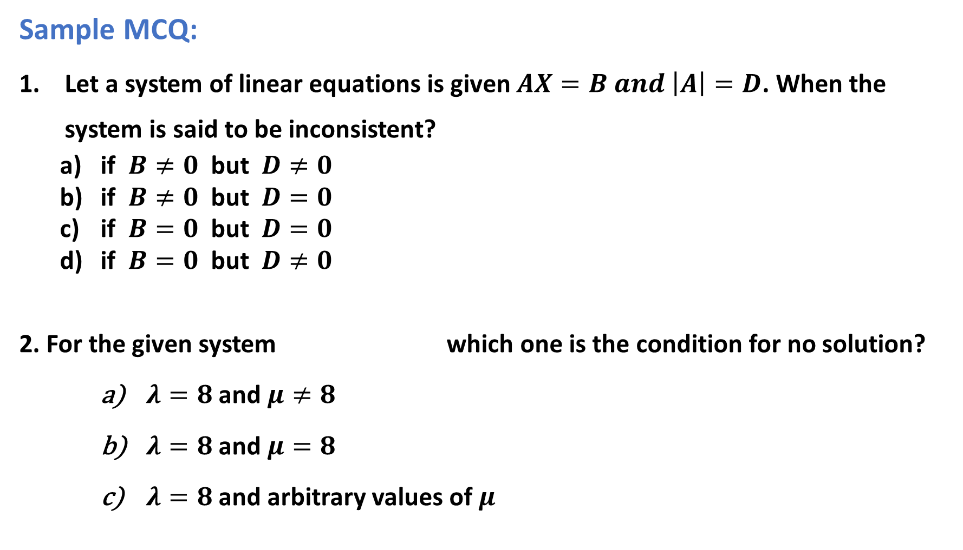
Sample MCQ:
Let a system of linear equations is given $AX=B and \left|A\right|=D$. When the system is said to be inconsistent?
if $B≠0$ but $D≠0$
if $B≠0$ but $D=0$
if $B=0$ but $D=0$
if $B=0$ but $D≠0$
2. For the given system which one is the condition for no solution?
$λ=8$ and $μ≠8$
$λ=8$ and $μ=8$
$λ=8$ and arbitrary values of $μ$
$$\left\{\begin{matrix}2x+3y+z=5 \\ 3x−y+λz=2 \\ x+7y−6z=μ\end{matrix}\right.$$

Slide 10

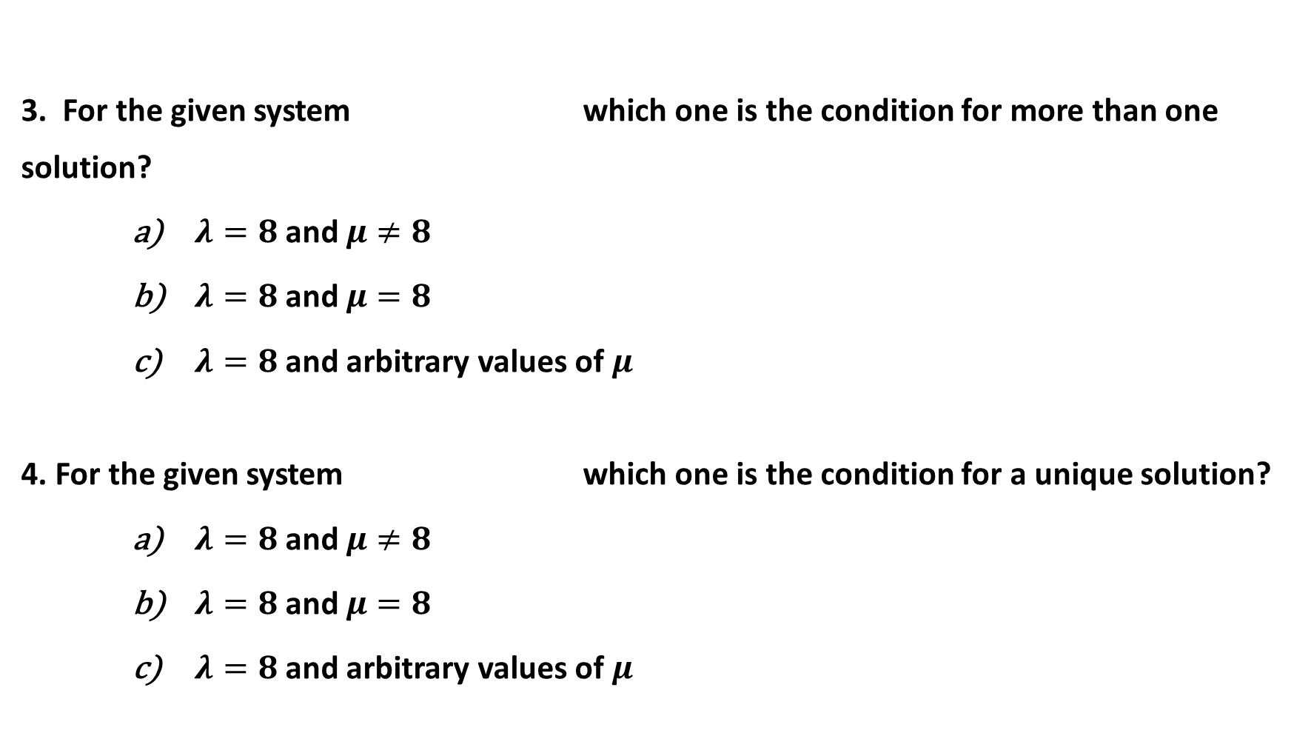

3. For the given system which one is the condition for more than one solution?
$λ=8$ and $μ≠8$
$λ=8$ and $μ=8$
$λ=8$ and arbitrary values of $μ$
4. For the given system which one is the condition for a unique solution?
$λ=8$ and $μ≠8$
$λ=8$ and $μ=8$
$λ=8$ and arbitrary values of $μ$
$$\left\{\begin{matrix}2x+3y+z=5 \\ 3x−y+λz=2 \\ x+7y−6z=μ\end{matrix}\right.$$
$$\left\{\begin{matrix}2x+3y+z=5 \\ 3x−y+λz=2 \\ x+7y−6z=μ\end{matrix}\right.$$

Slide 11

Outcome:
By applying Cramer’s rule, system of linear equations can be solved to find the solution of the system.
By applying some conditions, values of $μ$and $λ$ can be determined for no solution, more than one solution and a unique solution in a system of linear equation.

